Slide 1


Welcome
Project Title
Book Recommendation System For Public Domain Books in
Gutenberg Library
To
Our Project Presentation

Slide 2
Welcome
Project Title
Book Recommendation System For Public Domain Books in
Gutenberg Library
To
Our Project Presentation

Slide 3
Submitted by
SUPERVISED BY
Sadman Ishtiak
DR. MST. JANNATUL FERDOUS
Professor
Department of Computer Science and Engineering, JKKNIU
Roll: 22102009
Reg: 10815
Md. Jahid Hassan Khan Ornob
Roll: 22102035
Reg: 10841

Slide 4


Table of content
Introduction
01
02
Methodology
Here we will describe what the project will serve
Here we will describe the development stage.
Application Flow
03
04
User Interface
We will describe the flow of the project
We will see some interface of the project.
Limitations
06
Future scope
05
Here we will describe the limitations of the project.
Here are some future scope of the project.

Slide 5
Introduction
The Gutenberg library is a great resource for public domain books. However, it can be difficult to find the books that you want to read, especially if you are looking for something specific. This project makes it easier to find books in the Gutenberg library by getting a local book catalog, a read list, and a randomized recommendation system.
The local book catalog is a collection of all the books in the Gutenberg library. The read list is a list of books that you have already read. The randomized recommendation system recommends books to you based on your favorite genres.
This project makes it easier to find books in the Gutenberg library by giving you more control over your reading experience. You can browse the local book catalog to find books that you are interested in, or you can use the randomized recommendation system to get suggestions for new books to read. You can also keep track of the books that you have read on your read list.

Slide 6
Working Process
Methodology :
Step-1 : Start
Step-2 : User chooses a function
:
Search:
User enters title, author, or category.
System calls bookSearch() function to find matching books.
User chooses a book from results.
System offers options:
Add to read list
Add to wishlist
Open link to book (likely for purchase or further information)

Slide 7
Working Process
Methodology :
Step-1 : Start
Step-2 : User chooses a function
:
Recommend:
System generates random book suggestions.
User chooses a book from suggestions.
System offers options:
Add to read list
Add to wishlist
Open link to book

Slide 8
Working Process
Methodology :
Step-1 : Start
Step-2 : User chooses a function
Step-3 : End
:
List:
System displays either wishlist or read list.
User selects a book from the list.
System offers options:
Open link to book
Remove from list

Slide 9
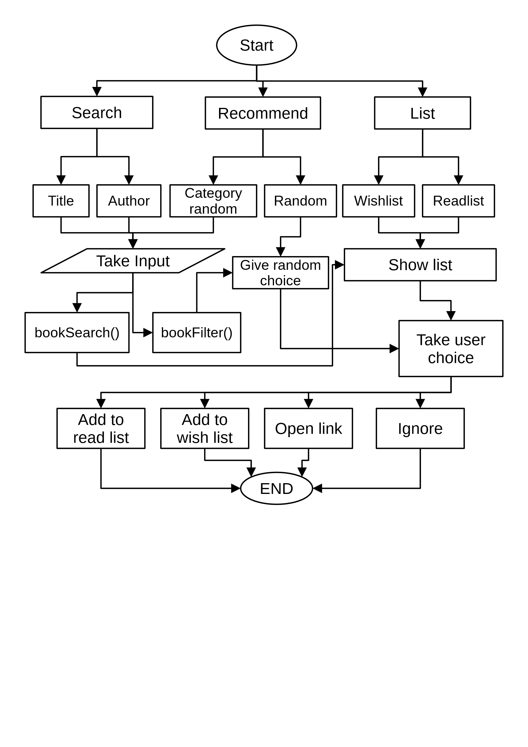
Application Flow

Slide 10
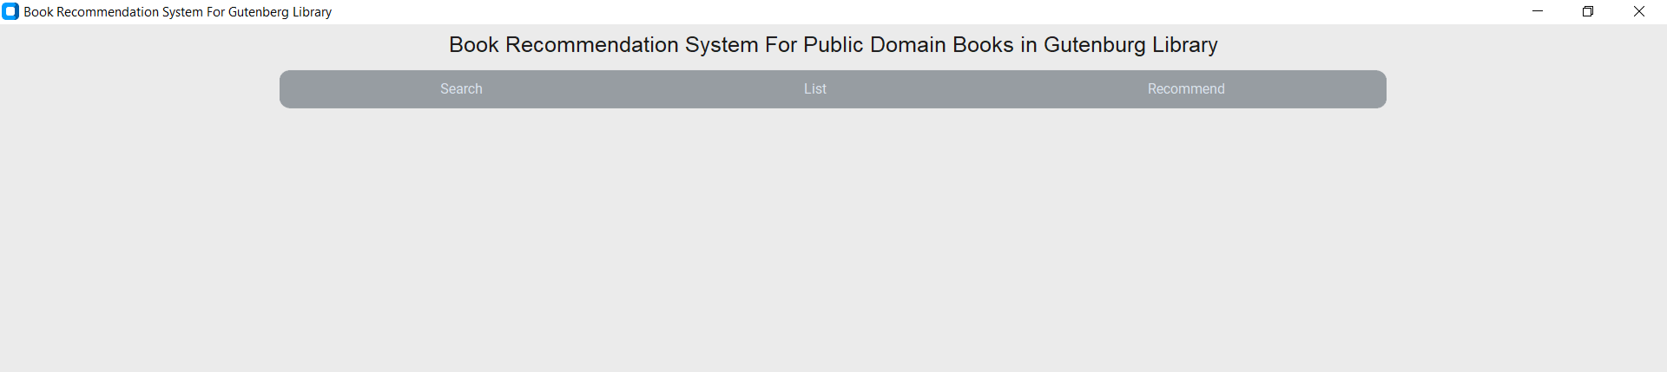
User interface
Category Selection Menu: The program starts with an opening menu where the user can select 1 out of 3 categories for him/her to solve to use in the program

Slide 11
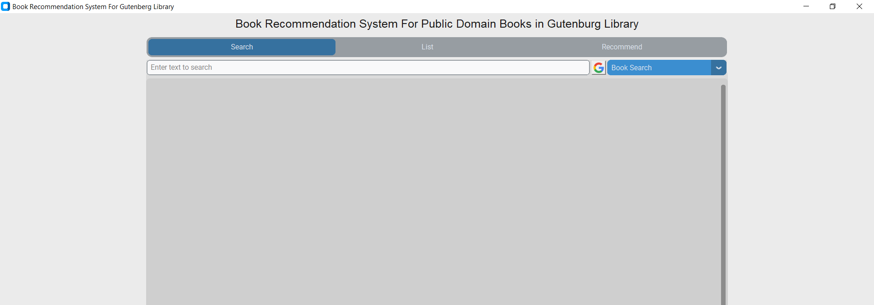
User interface
Search Category: Here user can search his desired book using the book name or author name. If the book is not listed in the CSV file then he can search it on Google using the google button beside the search bar.

Slide 12
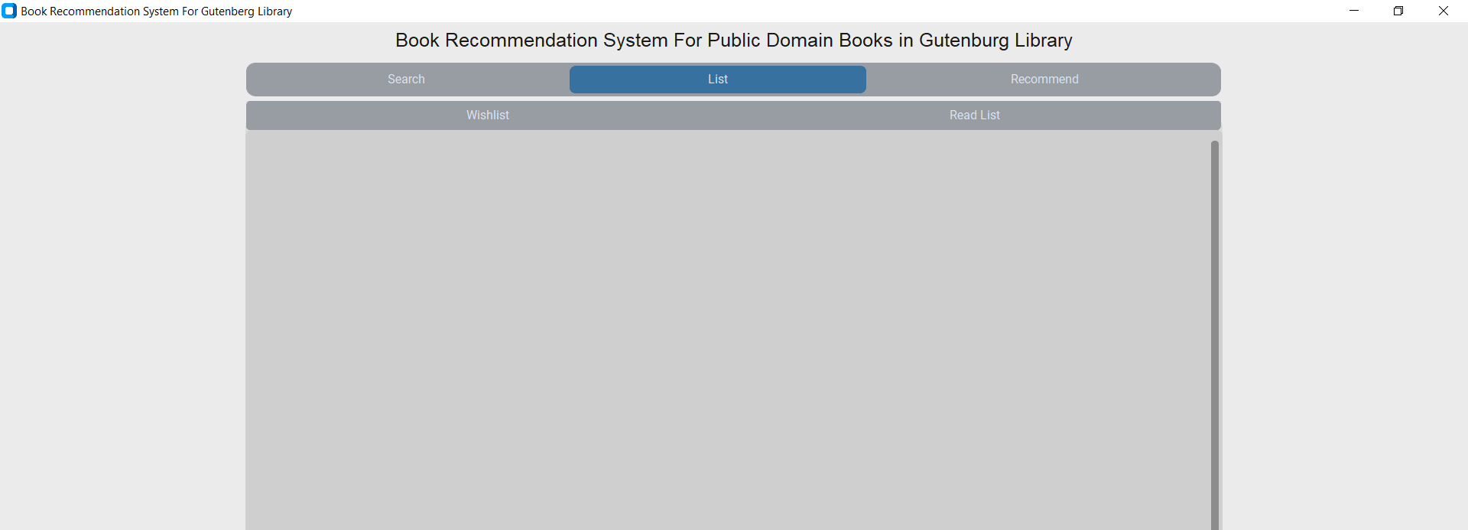
User interface
List Category: The list category is divided into two subcategories. One is a Wishlist where the books stored are what the user wants to read. The other is the Read List where already read books are stored.

Slide 13
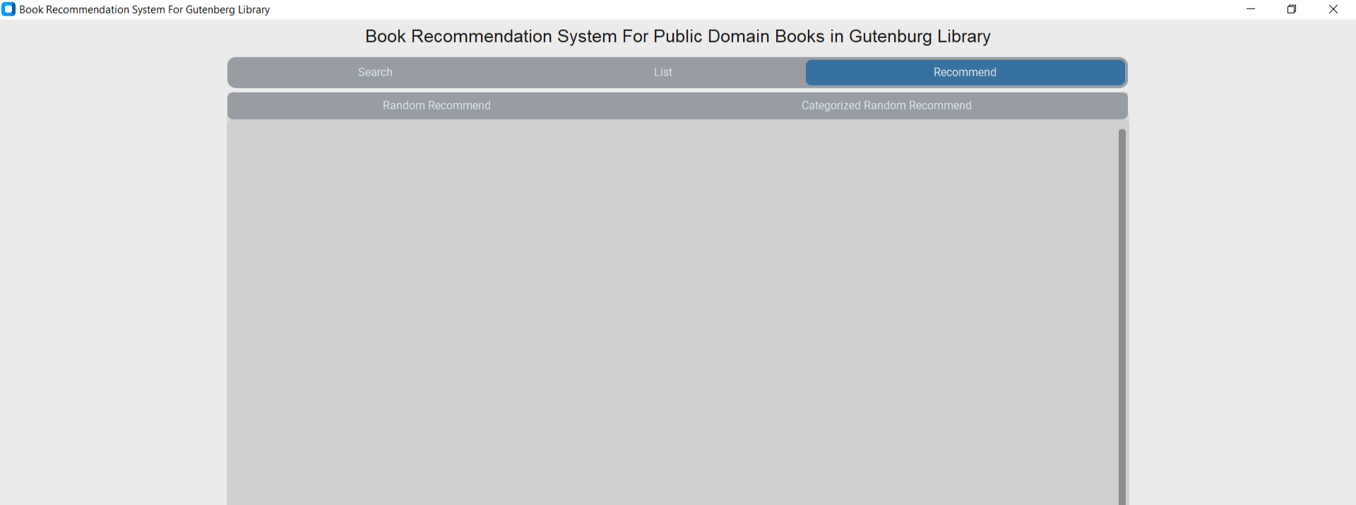
User interface
Recommend Category : The recommend category is divided into two subcategories. One is Random Recommend and the other is Categorized Recommend. If we click Random Recommend then a list of different types of books shows. And if we click Categorized Random Recommend then the user can access his preferred genre book using the genre name by search bar.

Slide 14
Limitations
The project Gutenberg only has a limited amount of books
The code uses a linear complete search to look for and filter through books causing the application to be slow
Customtkinter library when showing too many widgets requires more memory than desired
We do not have many color schemes due to the appearance theme limitation
It shows an error when we try to use the category recommended using text is not a type of book category

Slide 15
Future Scope
We would like to add automatic update system so the user can automatically update the library catalog from gutenberg.org
We would like to fix the category recommend error
We would like to increase the quality of the complete search that is used here
We would like to optimize the application so that more devices with different operating systems and weaker configurations can use this application
We would like to add some sort of statistical system so that the random suggestion is similar to the genre of the users previously read books

Slide 16
References
Python Documentation: https://docs.python.org/3.11/
Tkinter Documentation: https://docs.python.org/3/library/tkinter.html
Customtkinter Documentation: https://customtkinter.tomschimansky.com/documentation/

Slide 17

Thank you
for your patience

Slide 18

Any Questions?

